Slide 1





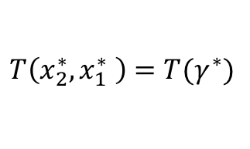




$$γ$$
$$Im(x)$$
$$x_{2}$$
$$T\left(x_{2},x_{1}\right)=T(γ)$$
$$x_{1}$$
$$Re(x)$$
$$T\left(x_{2}^{∗},x_{1}^{∗} \right)=T(γ^{∗})$$
$$x_{1}^{∗}$$
$$x_{2}^{∗}$$
$$γ^{∗}$$

Slide 2
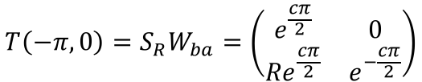
b
a
$$T\left(−π,0\right)=S_{R}W_{ba}=\left(\begin{matrix}e^{\frac{cπ}{2}} & 0 \\ {Re}^{\frac{cπ}{2}} & e^{−\frac{cπ}{2}}\end{matrix}\right)$$

Slide 3
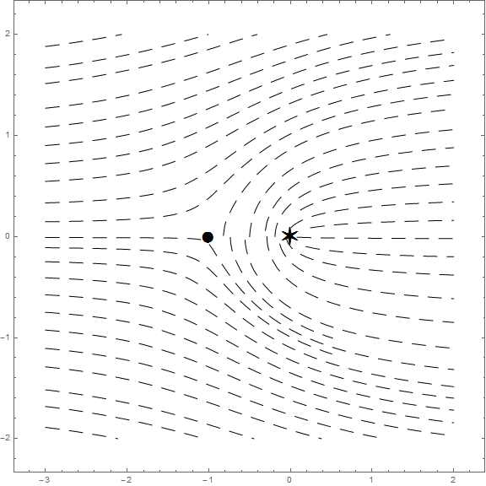
-S
5
4
6
1
3
2
-R

